Slide 1
Movie Data Visualization
By: Sydney Babb

Slide 2
Business Decision: How does the budget/rating/popularity correlate with the revenue?
Budget
Rating
Popularity
Revenue

Slide 3
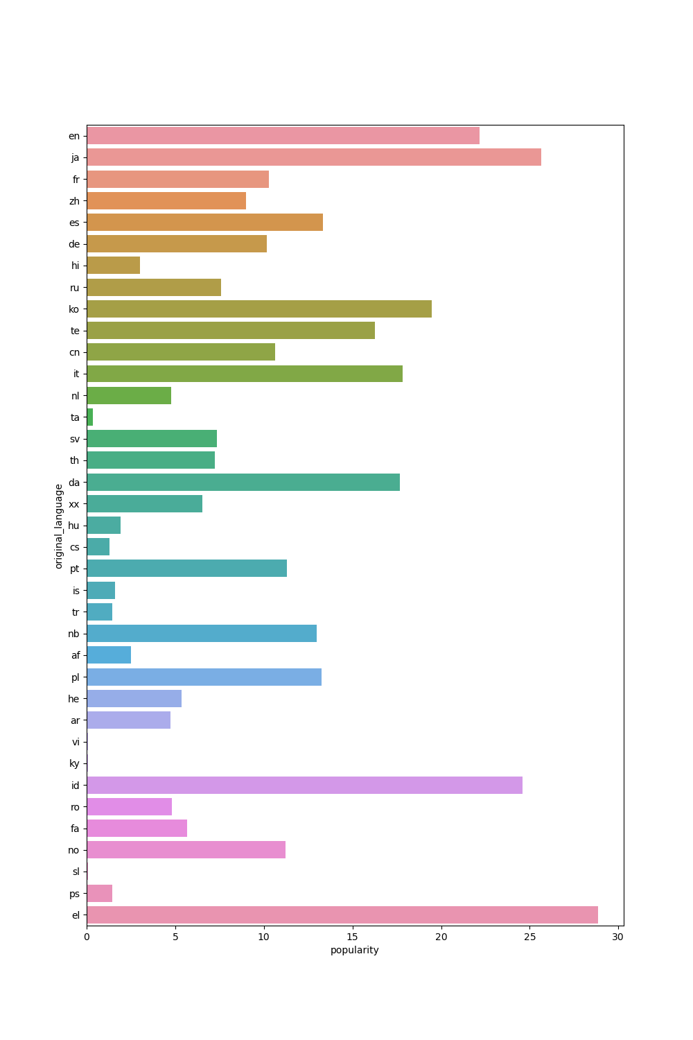
Show popularity among languages used in the movies:
Greek, Japanese, Indonesiaian is most popular spoken language original curated for among the movie data.

Slide 4
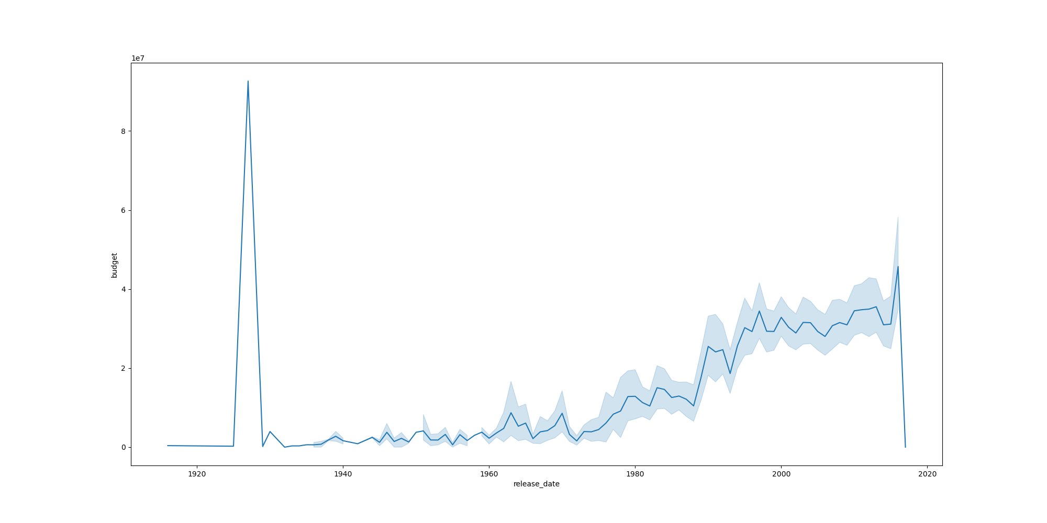
Show the trend among movie budgets each year:
Movies released earlier between 1920 and 1940 had higher budgets, while movies released in 80s to 2000s saw a budget increase (not as high between 1920 and 1940).

Slide 5
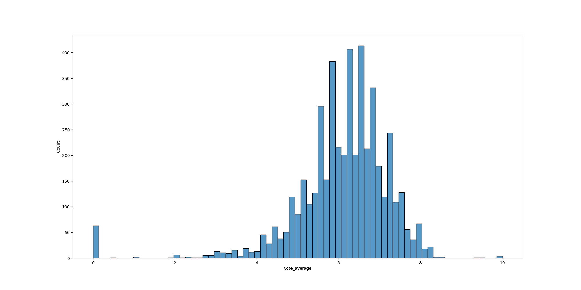
Show the distribution among movie ratings:
There are higher peaks of average reviews between 5 and 7. There is a spread between average reviews below 4. The histogram is slightly left skewed (negatively skewed) mean < median < mode.“

Slide 6
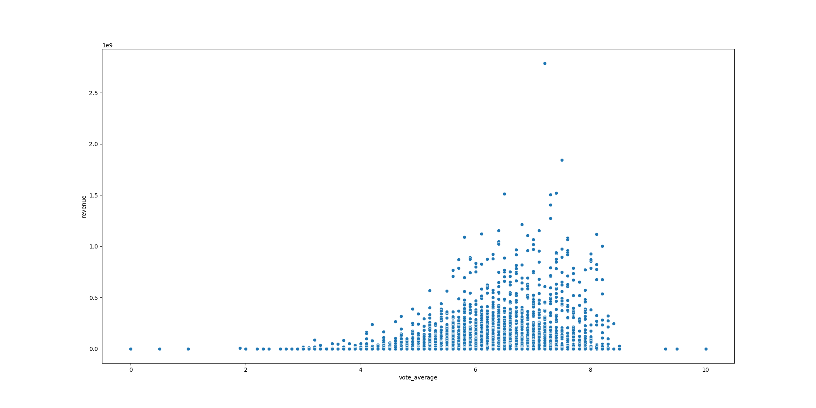
Relationship between average rating and revenue:
The clustering between average votes of 5 and 8 (No correlation).

Slide 7
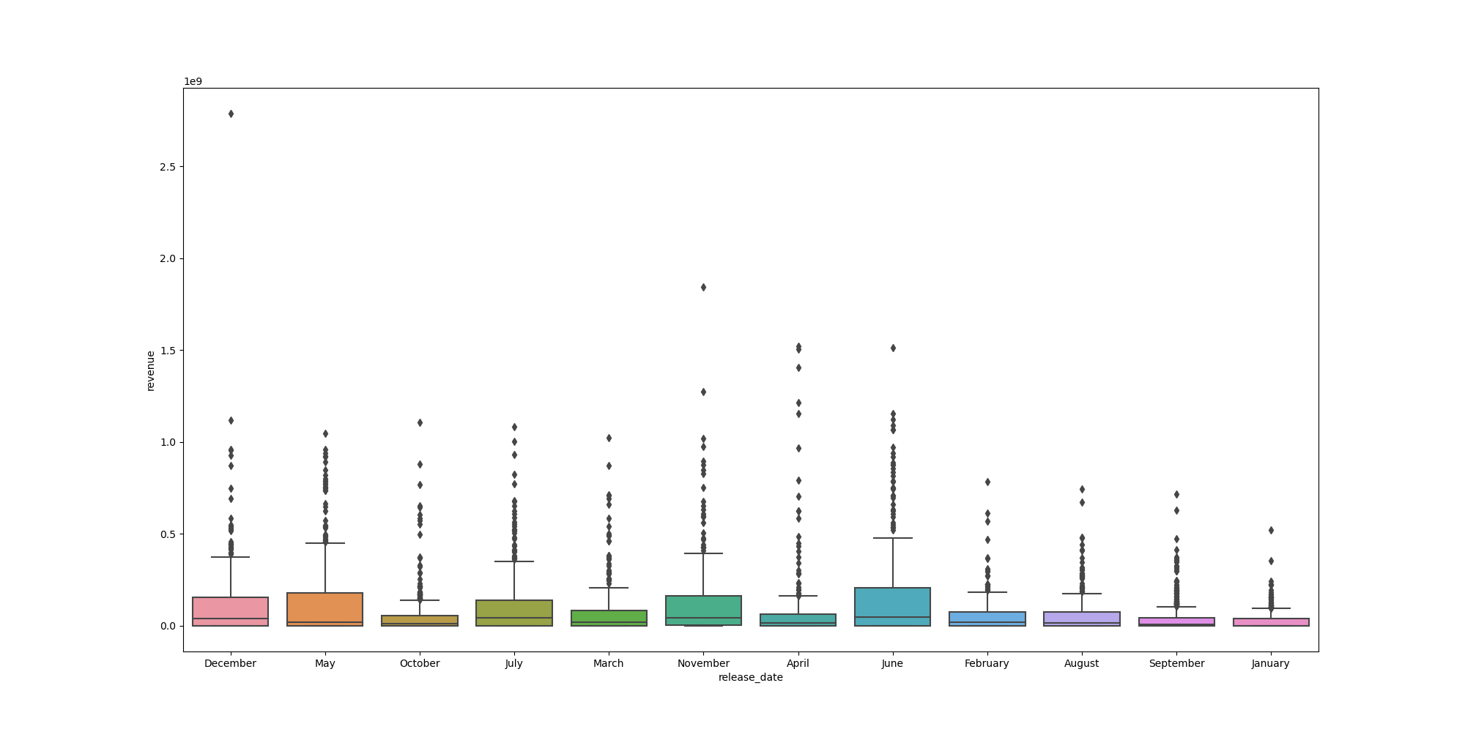
Show distribution of revenue among release months from movie data:
Summer and Holiday months generate the most in revenue.

Slide 8
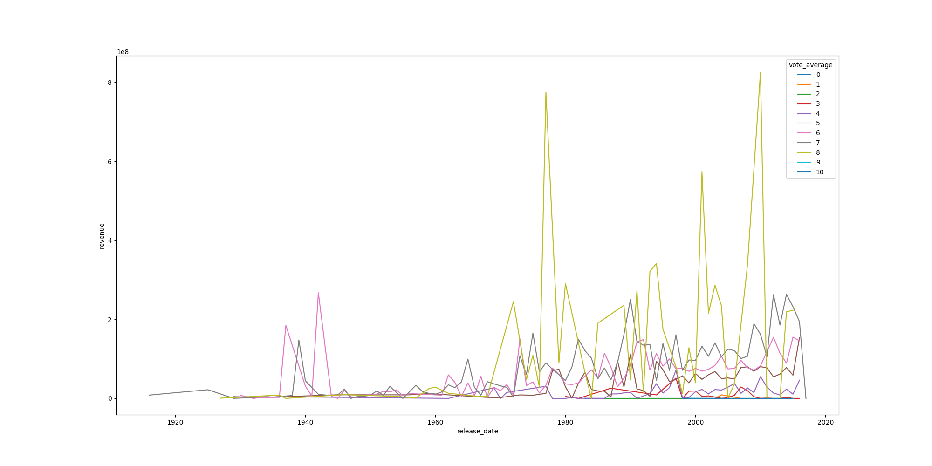
Show the trend every year the revenue generated based off the rating:
The rating average between 7 and 8 generates the most in revenue.

Slide 9
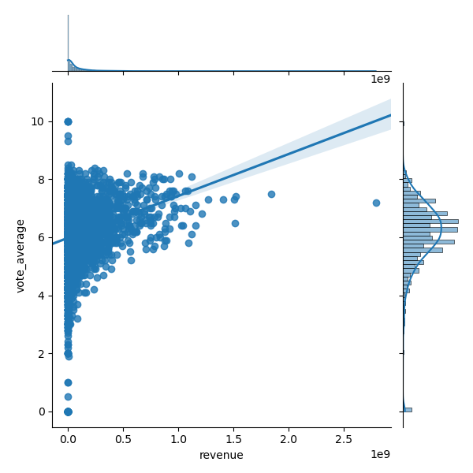
How does rating influence the revenue generated?:
A rating between 6 - 8 generates the most in revenue.

Slide 10
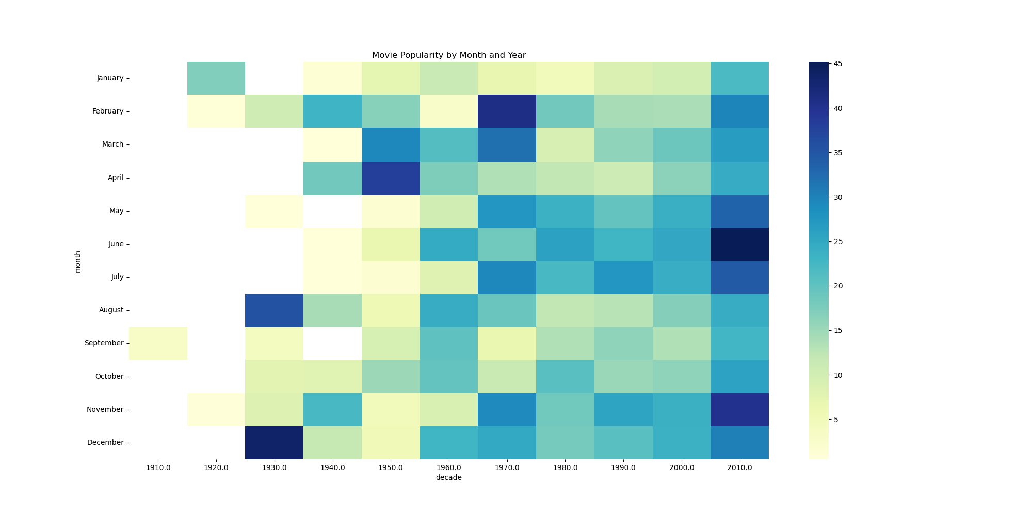
Movie Popularity based off of the release data:
Summer and Holiday months had the most movie popularity. 2010s had more popularity of movies. (advertising).

Slide 11
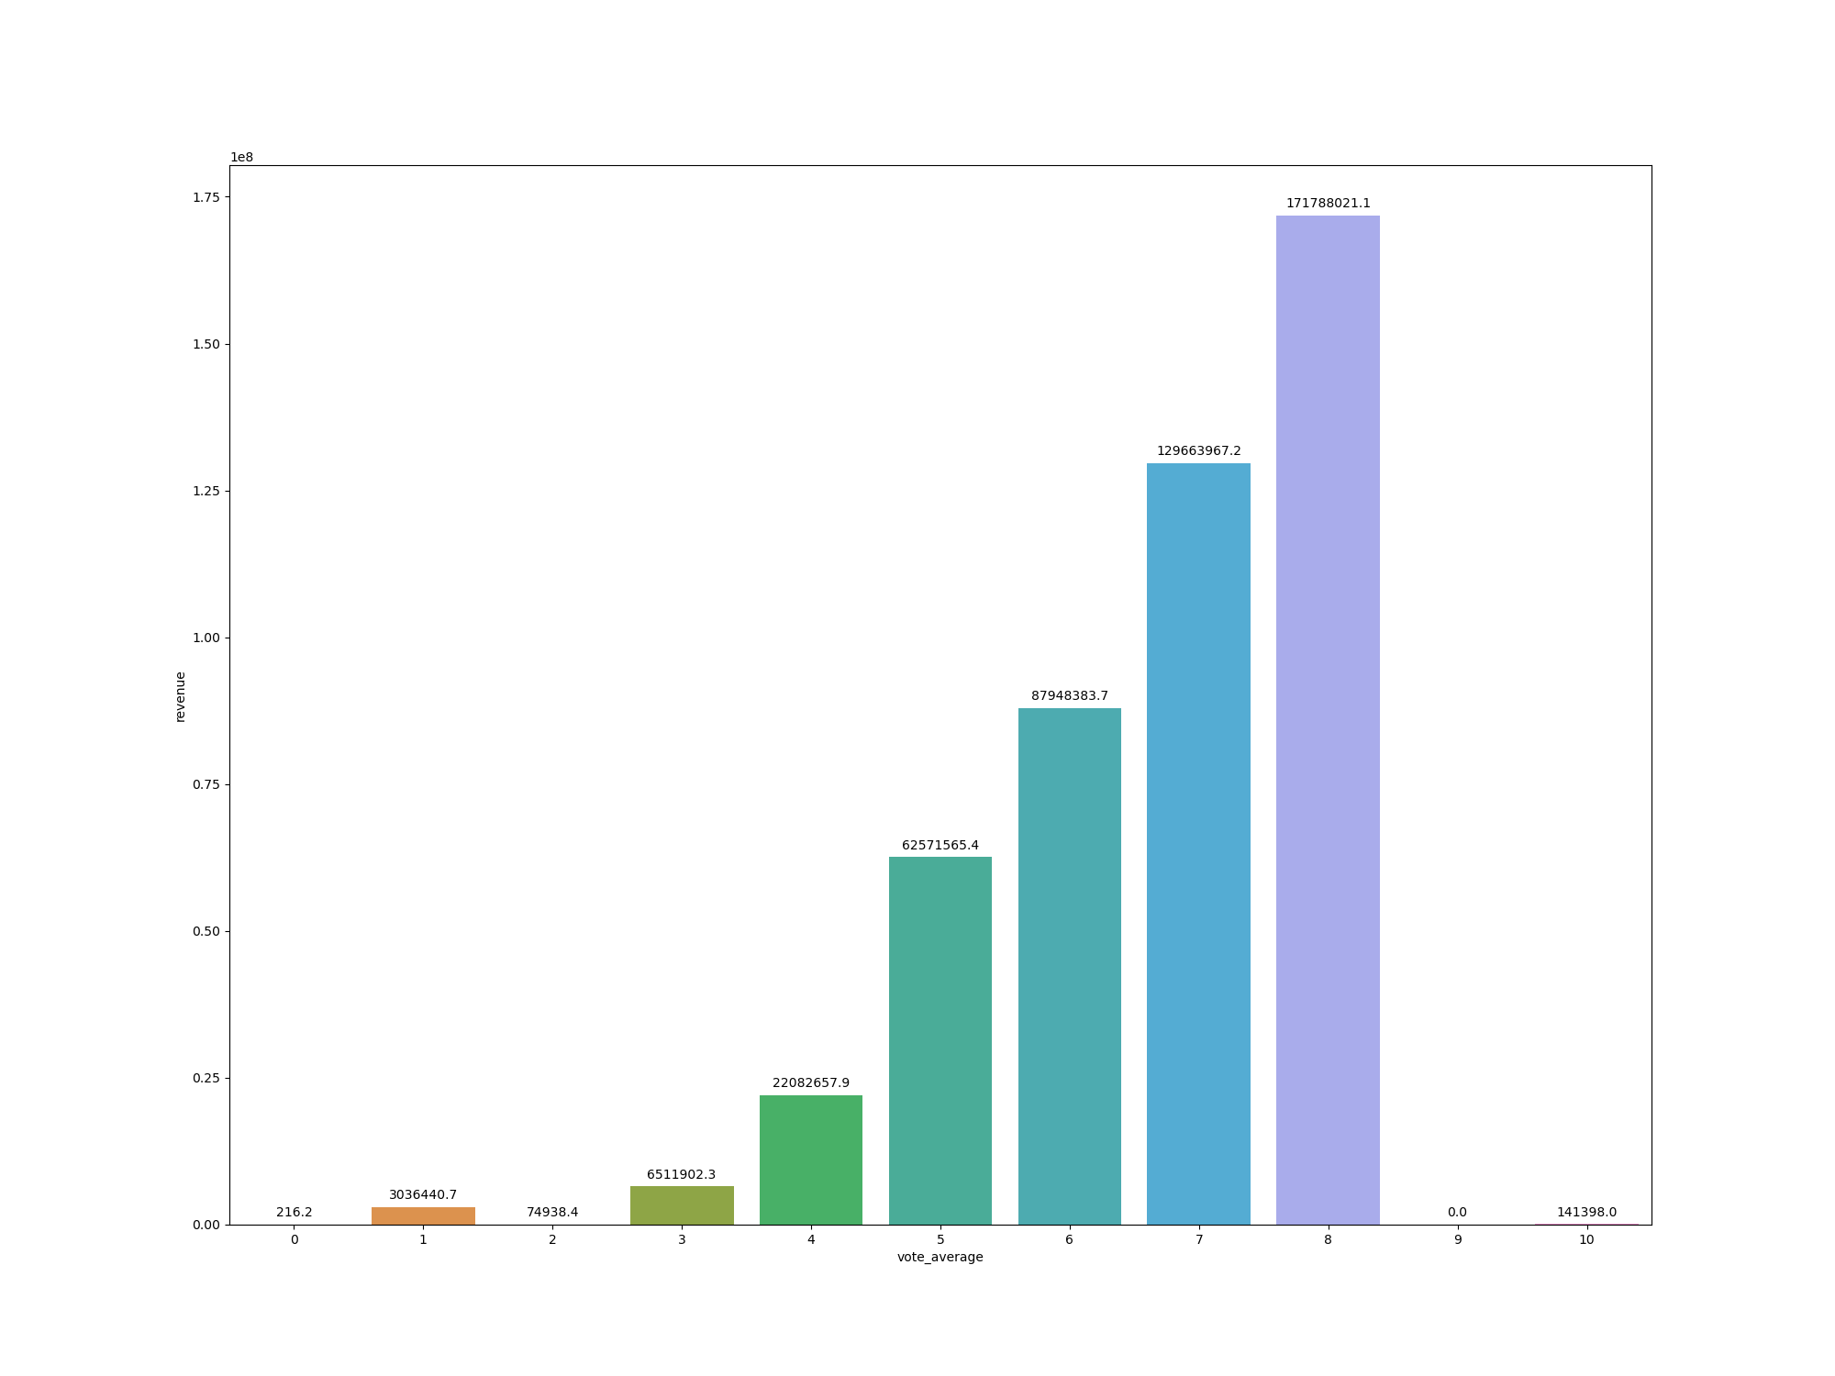
Scale of revenue generated based off of the rating:
Ratings between 5 and 8 generate the most in revenue, while ratings below 4 and higher than 8 generate the least.

Slide 12
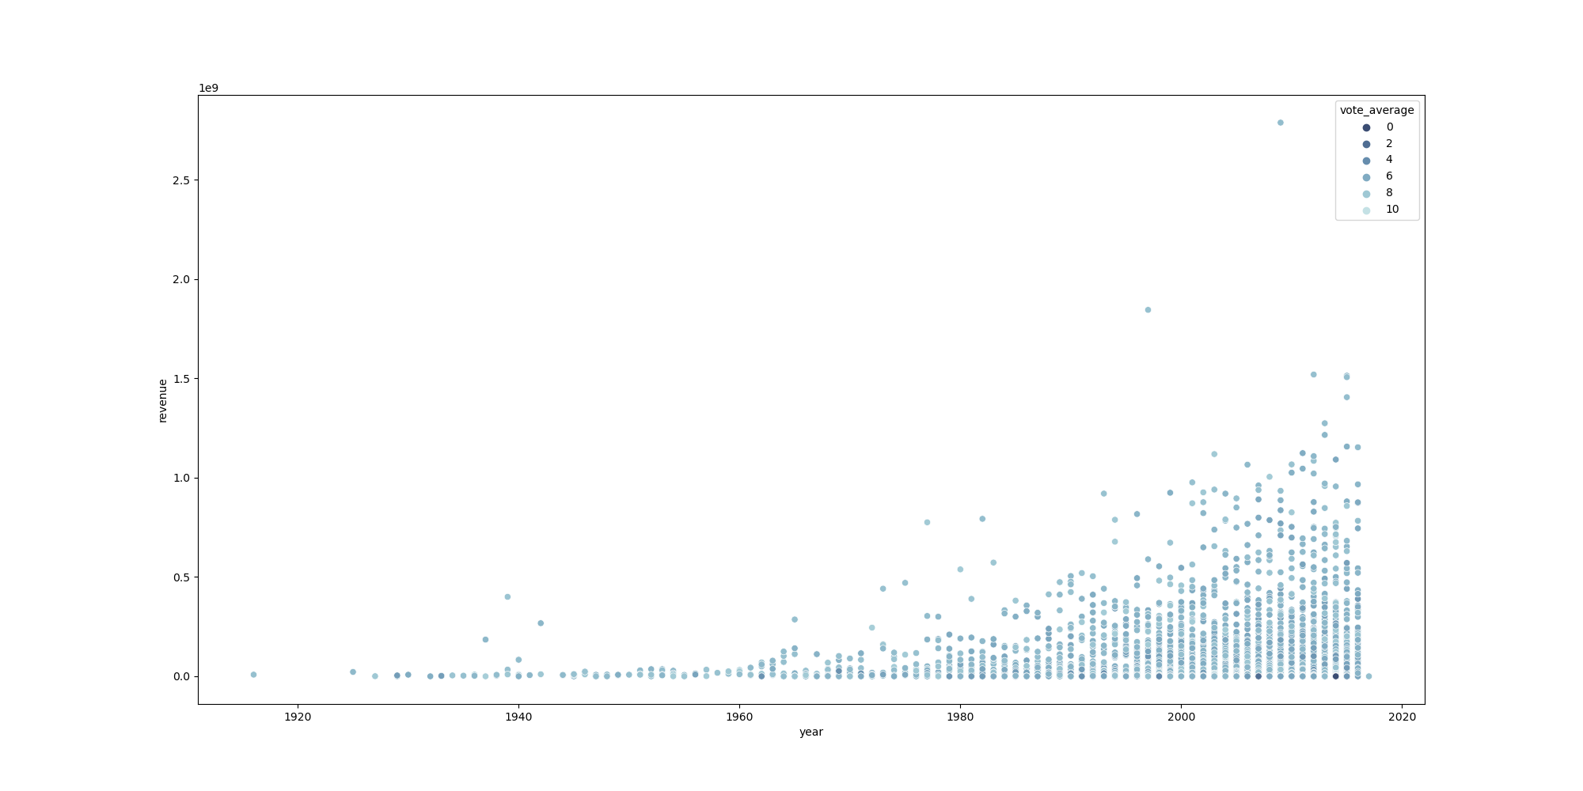
Relationship between rating and revenue throughout the release year:
Rating of 6 to 8 generates the most in revenue, while rating below 4 and between 9 to 10 generates the least.

Slide 13
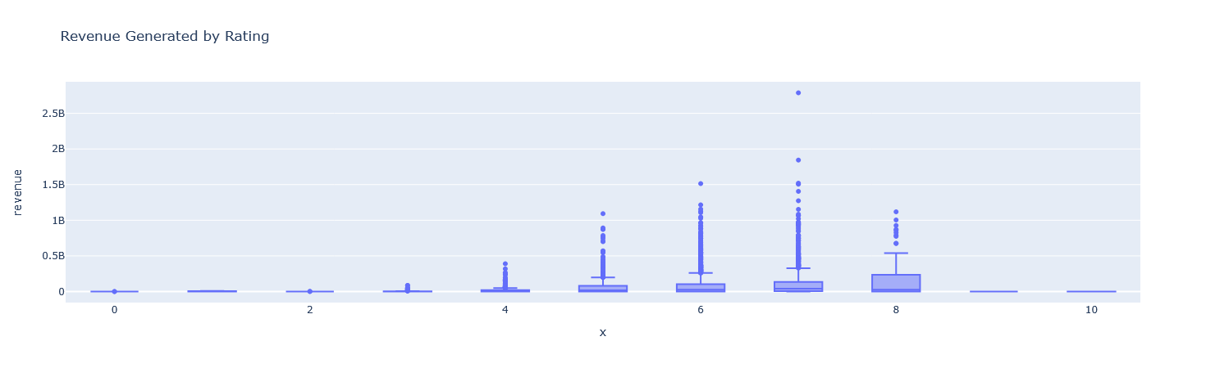
Show the distribution and quartiles of revenue generated each rating:
Ratings 5-8 generate most in revenue (no correlation). Ratings below 5 generate no revenue (slight negative correlation) and ratings 9-10 generate no revenue (no correlation).

Slide 14
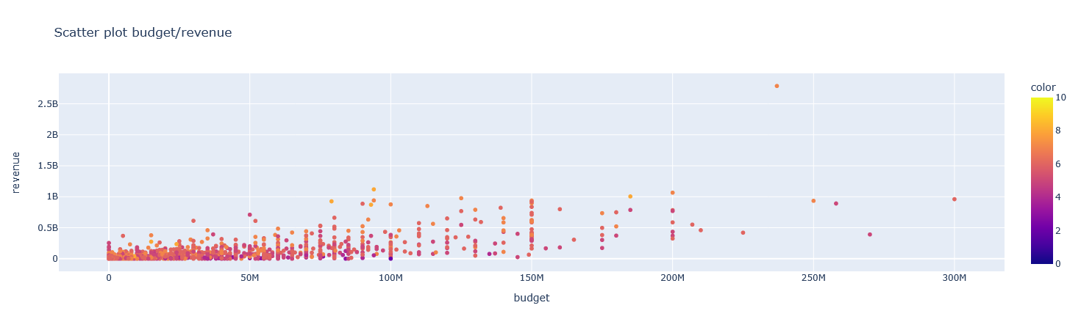
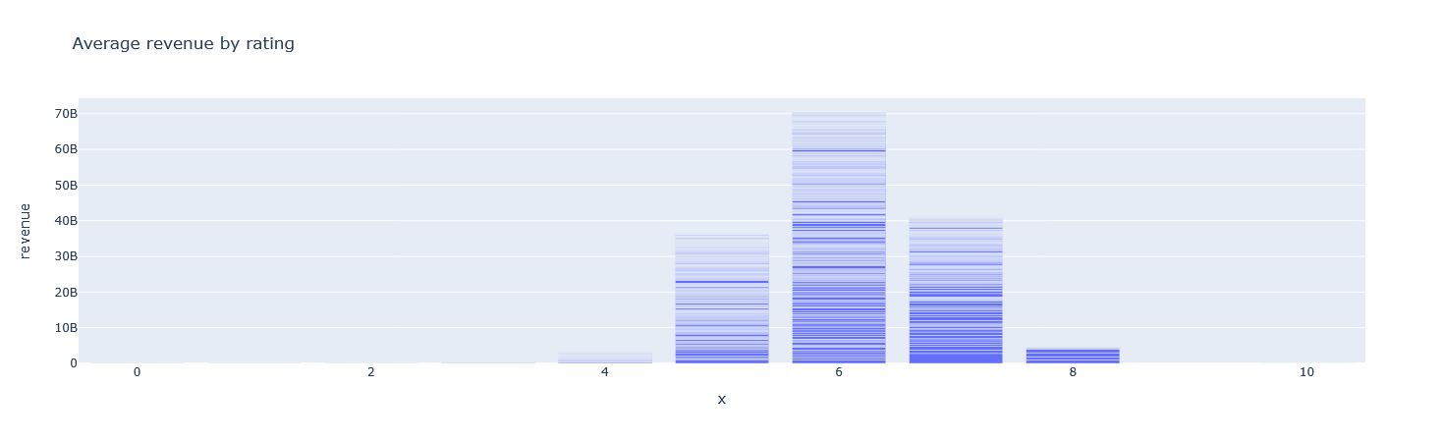
Interactive Dashboard: Does budget and rating correlate with revenue?:
Lesser the budget less revenue generated and higher the budget more revenue generated. Ratings between 5 to 8 generate the most in revenue (no correlation).

Slide 15
Business Decision: How does the budget/rating/popularity correlate with the revenue?
In conclusion, while quality and popularity matter, financial investment remains the strongest predictor of box office success.

